Slide 1
SAOCOM InSAR DEM Validation
A Land Cover-Stratified Analysis Key Pillars: • Vertical Accuracy Assessment • Land Cover Performance • Spatial Coverage & Void Analysis
SAOCOM InSAR Validation Study | Slide 1

Slide 2
Datasets & Study Area
Study Area: Verona, Italy • Constrained to SAOCOM data hull • All data projected to UTM Zone 32N
SAOCOM InSAR Validation Study | Slide 2

Slide 3
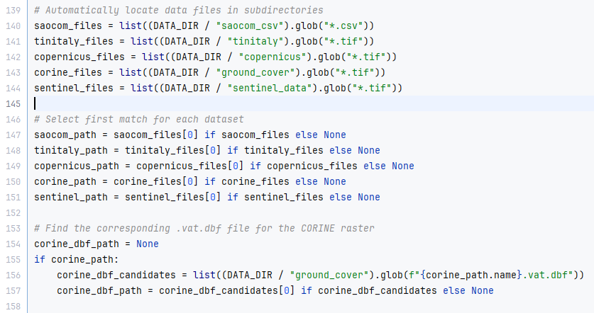
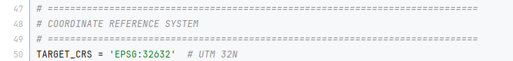
Datasets & Study Area
SAOCOM: L-band InSAR point cloud Reference Data: • TINITALY 10m DEM • Copernicus 30m DEM • CORINE 2018 Land Cover
SAOCOM InSAR Validation Study | Slide 2

Slide 4
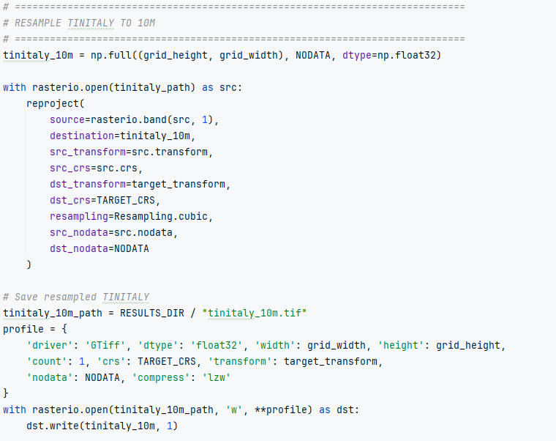
Core Processing Parameters
Coherence Filter: γ ≥ 0.3 • Purpose: Removes noisy, unstable points to ensure data quality. Grid Resolution: 10 meters • Purpose: Matches the highest-resolution reference (TINITALY). Resampling: • Cubic Convolution for elevation (smooths surfaces). • Nearest Neighbor for land cover (preserves classes).
SAOCOM InSAR Validation Study | Slide 3

Slide 5
Statistical Metrics Used
Classical Metrics: • Bias (ME): Systematic error. • RMSE: Overall error magnitude (sensitive to outliers). Robust Metrics: • Median: Central tendency (resists outliers). • NMAD: Robust standard deviation. Why robust? Our data has outliers; these metrics give a truer picture of performance.
SAOCOM InSAR Validation Study | Slide 7

Slide 6
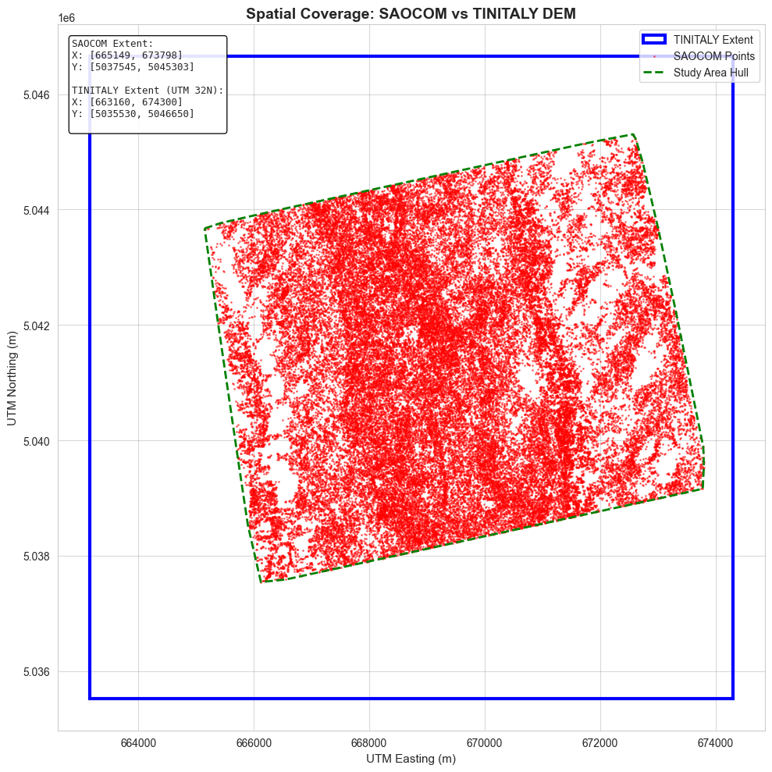
SAOCOM Spatial Coverage Analysis
Every “pixel” is a 10m² square and is a Boolean if a saocom pixel is present or not, Void Percentage: 87.0% This means for every 10 pixels in the study area, nearly 9 have no SAOCOM data. What land cover types are in these voids?
SAOCOM InSAR Validation Study | Slide 10

Slide 7
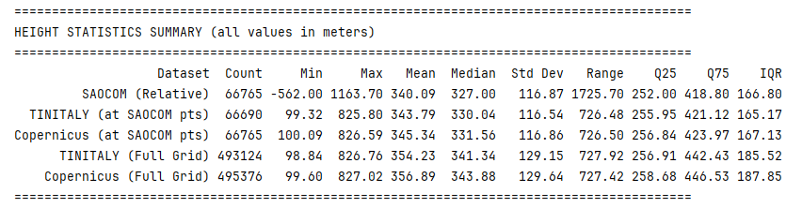
Height Statistics Summary
This table shows the fundamental statistical distributions for all elevation datasets. Note the large range of the raw SAOCOM data and the differences in mean/median values, underscoring the need for calibration.
SAOCOM InSAR Validation Study | Slide 8

Slide 8
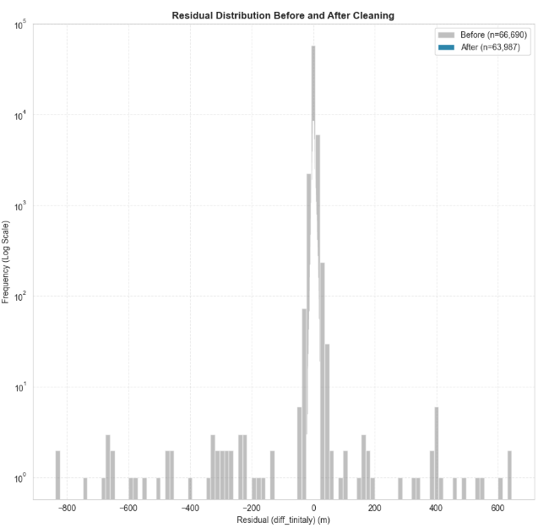
Height Statistics Summary
This table shows the fundamental statistical distributions for all elevation datasets. Note the large range of the raw SAOCOM data and the differences in mean/median values, underscoring the need for calibration.
SAOCOM InSAR Validation Study | Slide 8

Slide 9
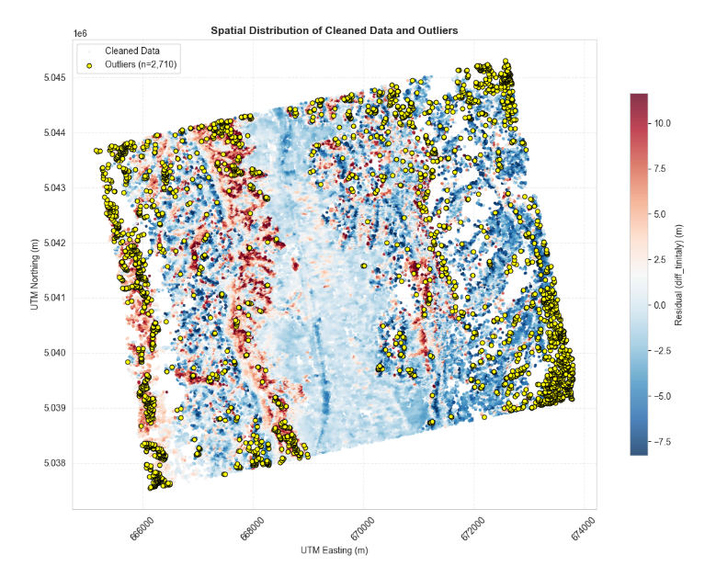
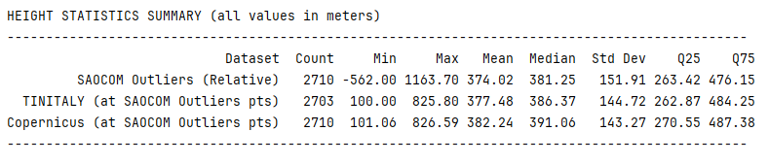
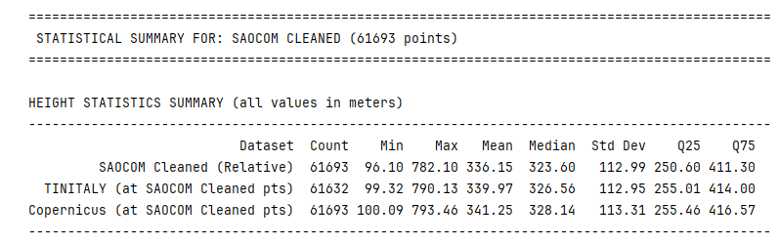
Data Preprocessing Workflow
SAOCOM: 1. Filter by coherence (γ ≥ 0.3). 2. Remove invalid points. 3. Apply k-NN algorithm to remove spatial outliers.
4. Apply Isolation Forest to remove vertical outliers
Three-dimensional Visualization
SAOCOM InSAR Validation Study | Slide 4

Slide 10
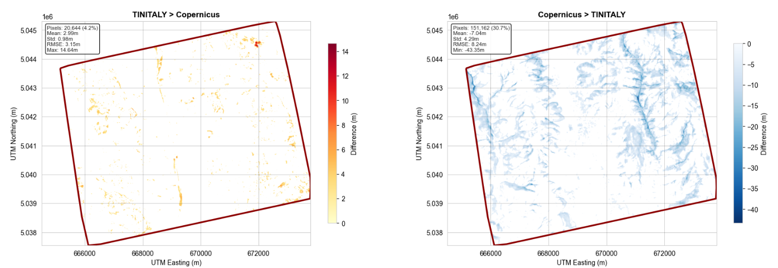
Reference DEM Comparison
This figure visually breaks down the differences between the two reference DEMs. The maps highlight spatial patterns of disagreement, while the histogram shows the statistical distribution.
SAOCOM InSAR Validation Study | Slide 9

Slide 11
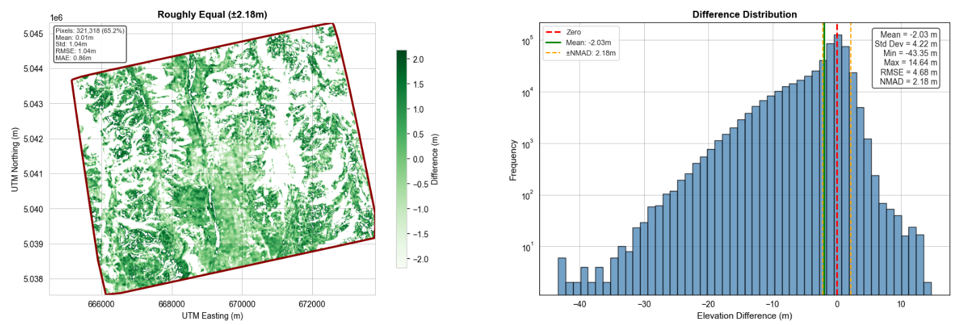
Reference DEM Comparison
This figure visually breaks down the differences between the two reference DEMs. The maps highlight spatial patterns of disagreement, while the histogram shows the statistical distribution. [Placeholder for Figure 1: 8-Panel Reference DEM Comparison]
Tinitialy – Copernicus
SAOCOM InSAR Validation Study | Slide 9

Slide 12
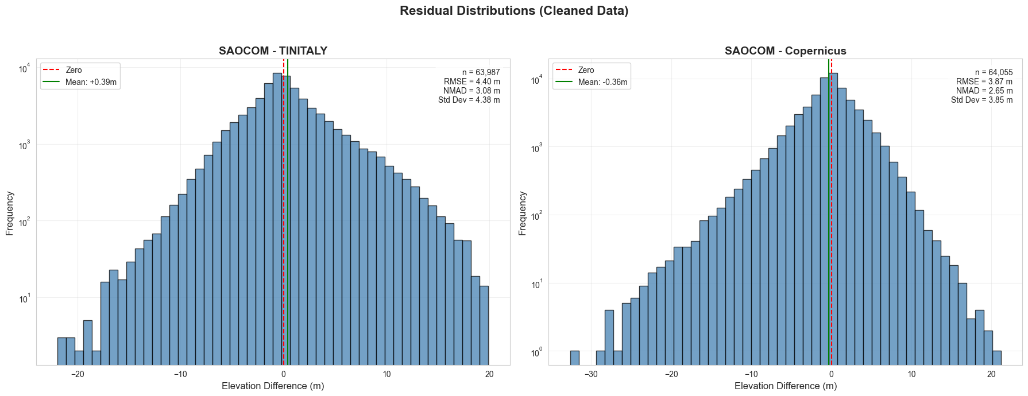
Reference DEM Comparison
SAOCOM InSAR Validation Study | Slide 9

Slide 13
Reference DEM Comparison
This figure visually breaks down the differences between the two reference DEMs. The maps highlight spatial patterns of disagreement, while the histogram shows the statistical distribution. [Placeholder for Figure 1: 8-Panel Reference DEM Comparison]
Tinitialy – Copernicus
SAOCOM InSAR Validation Study | Slide 9

Slide 14
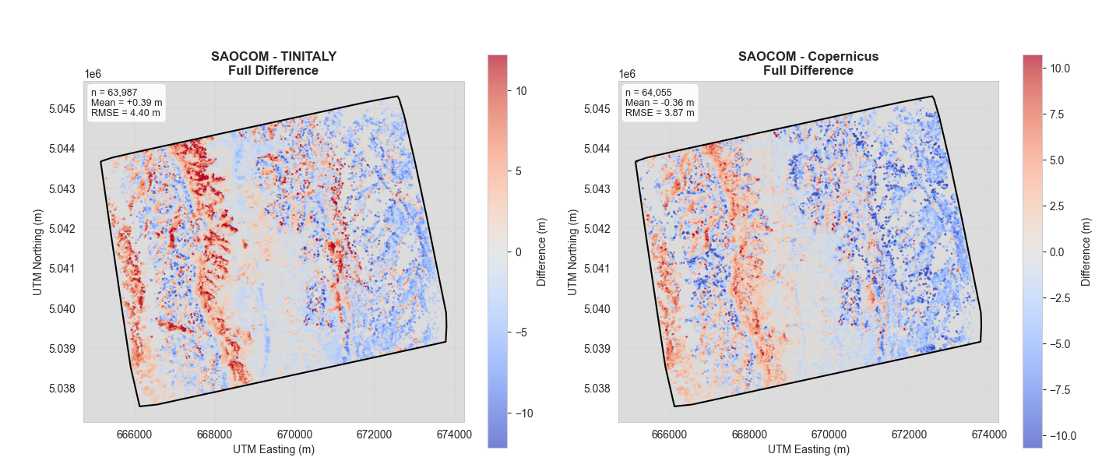
Gridded SAOCOM Residuals
The point-based errors were interpolated into a continuous map. This allows us to visualize the spatial patterns of where the SAOCOM DEM is higher or lower than the reference DEMs. [Placeholder for Figure 6: 6-Panel Gridded SAOCOM Residual Map]
SAOCOM InSAR Validation Study | Slide 18

Slide 15
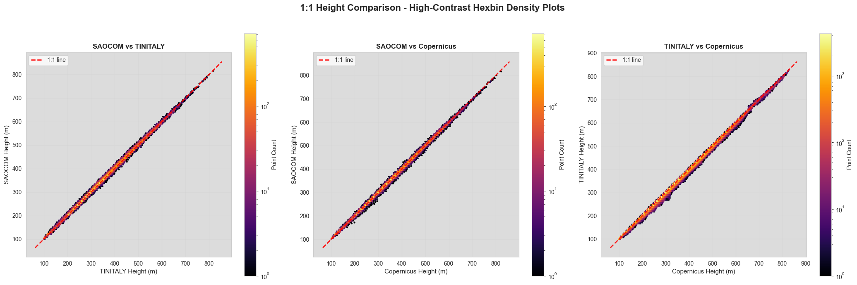
Height Correlation
These plots directly compare elevation values. While there is a strong linear relationship (high correlation), the spread of points around the 1:1 line visually represents the error.
SAOCOM InSAR Validation Study | Slide 19

Slide 16
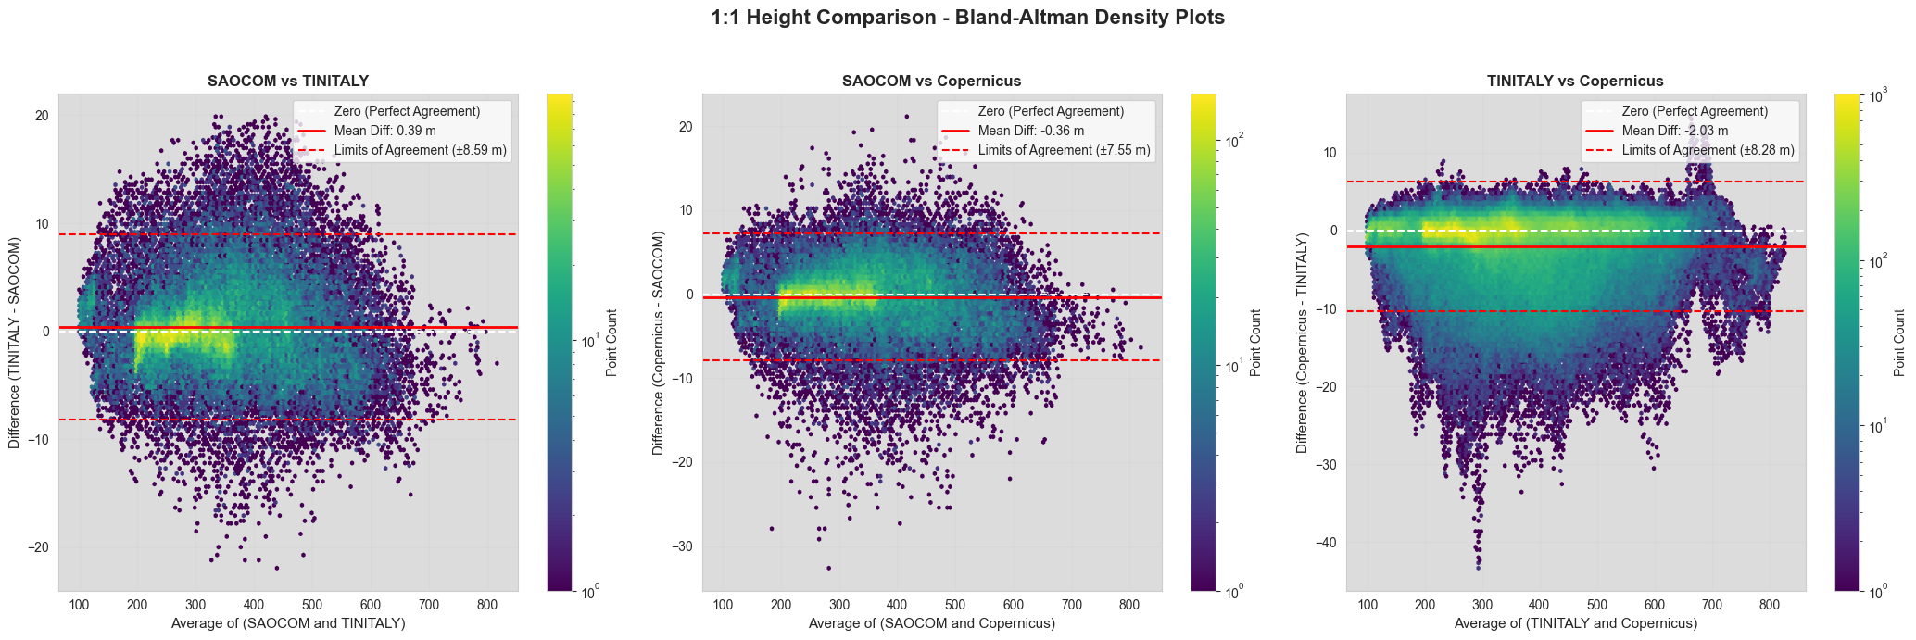
Height Correlation
These plots directly compare elevation values. While there is a strong linear relationship (high correlation), the spread of points around the 1:1 line visually represents the error.
SAOCOM InSAR Validation Study | Slide 19

Slide 17
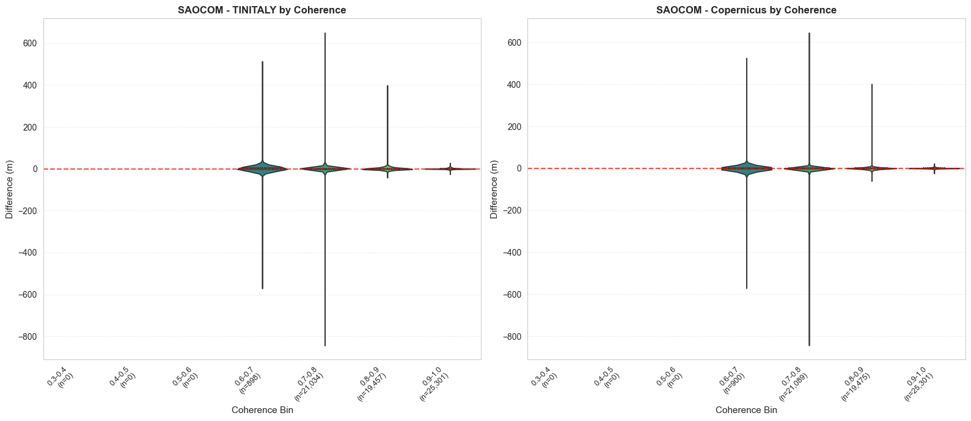
Error vs. Coherence
These plots show the clear relationship between signal quality (coherence) and accuracy. As coherence increases, the error distribution tightens significantly, and the median error approaches zero.
SAOCOM InSAR Validation Study | Slide 15

Slide 18
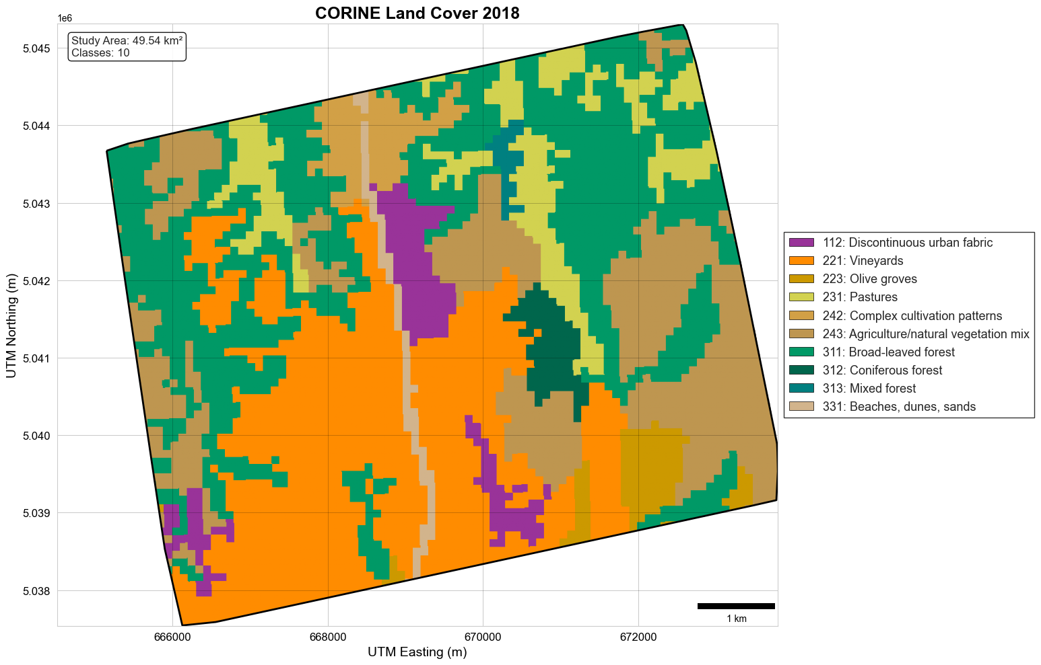
CORINE Land Cover
The CORINE 2018 dataset was processed to classify the terrain. • 10 classes were found in the study area. • A custom color palette was used for clarity in all subsequent maps and charts.
SAOCOM InSAR Validation Study | Slide 11

Slide 19
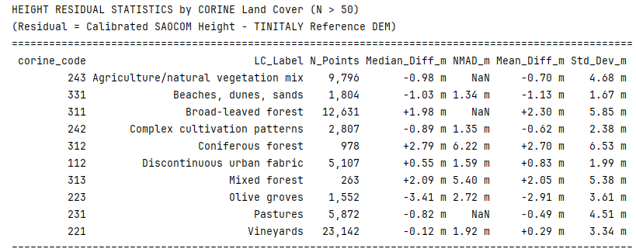
Height Residuals by Land Cover
This table shows the error statistics for each land cover class. Performance varies significantly. Urban areas show lower error (NMAD < 3.5m), while forests show much higher error (NMAD > 5m).
SAOCOM InSAR Validation Study | Slide 13

Slide 20
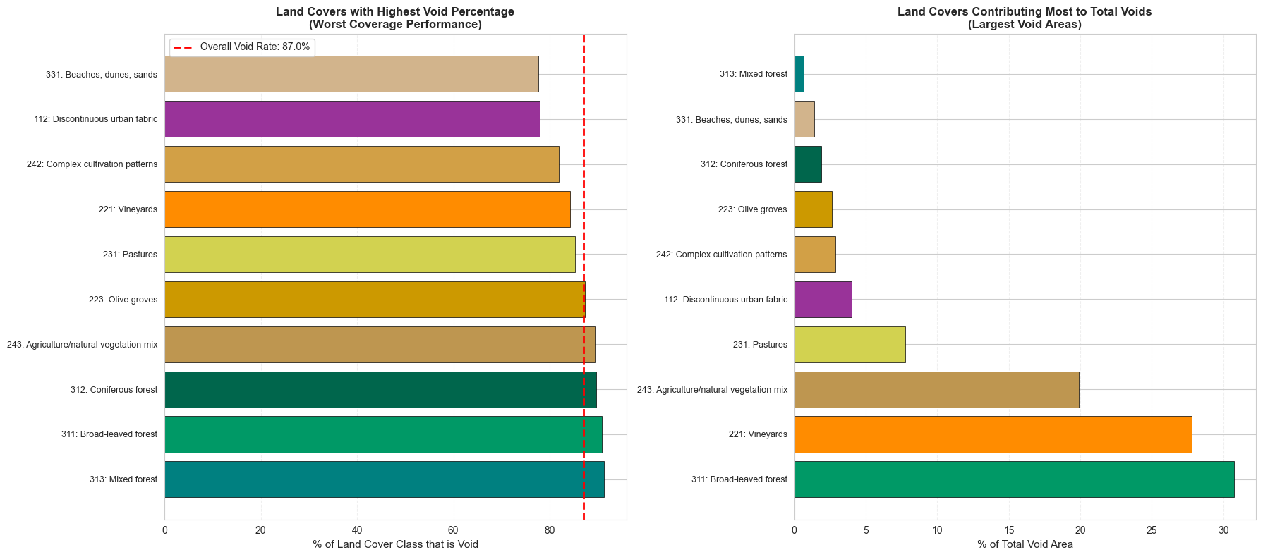
Void Analysis by Land Cover
Thse graphs quantifies which land cover classes are most affected by data gaps. Water bodies and forests are almost entirely voids, while vineyards and forests are the largest contributors to the total void area.
SAOCOM InSAR Validation Study | Slide 14

Slide 21
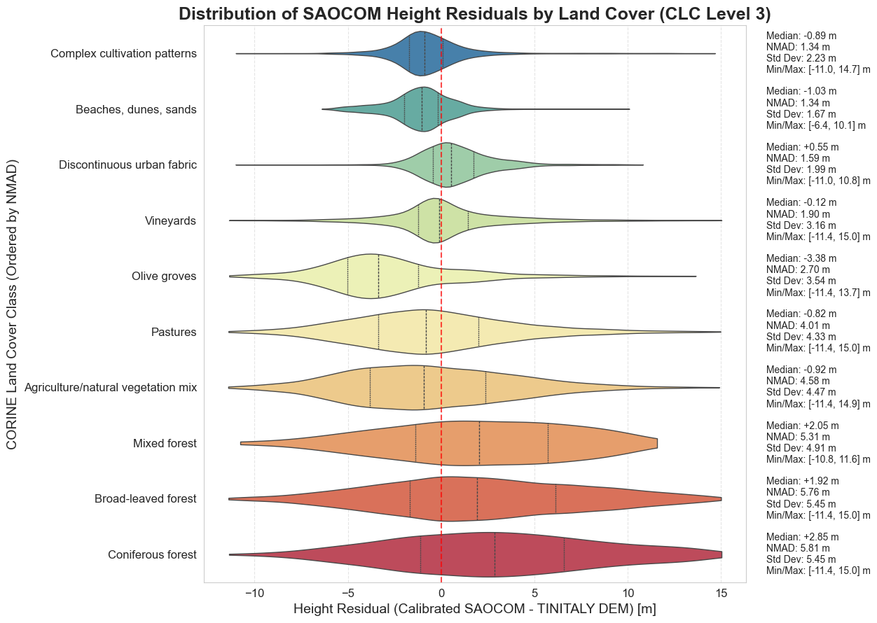
Error by Land Cover
These plots visualize the error distributions for each major land cover class. Note the wide shape for forests (high uncertainty) compared to the narrow shape for urban fabric (more reliable).
Drop Image/Figure Here
SAOCOM InSAR Validation Study | Slide 16

Slide 22
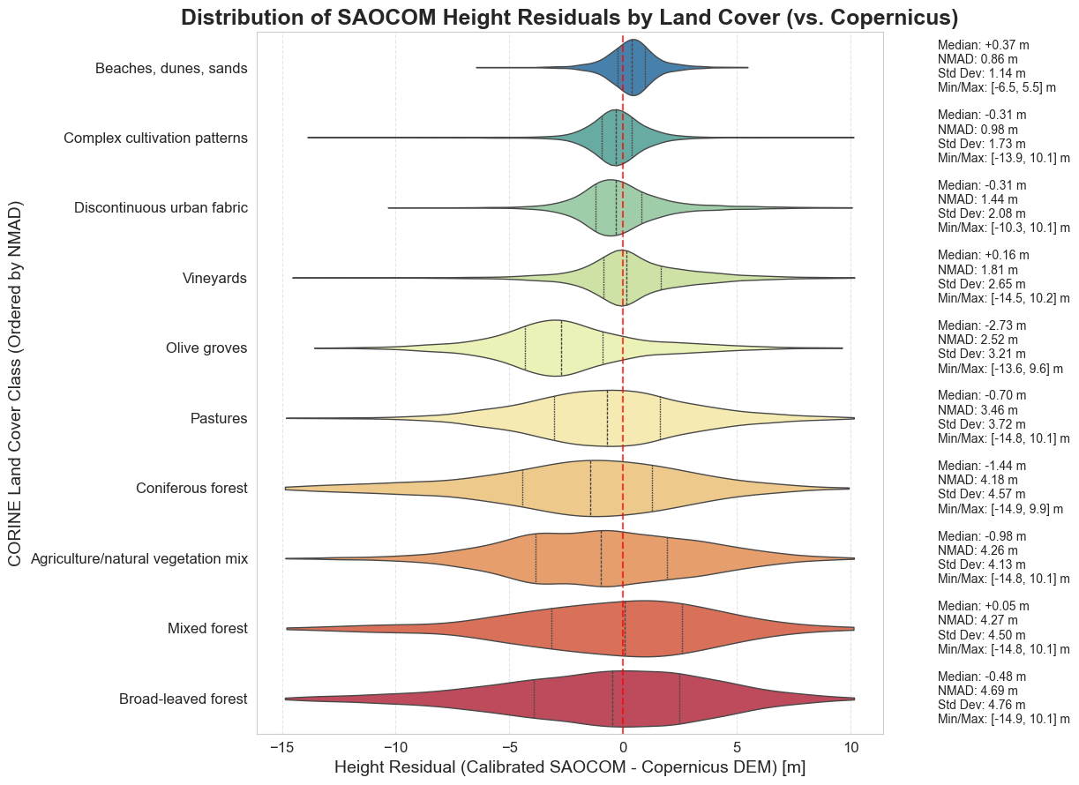
Error by Land Cover
These plots visualize the error distributions for each major land cover class. Note the wide shape for forests (high uncertainty) compared to the narrow shape for urban fabric (more reliable).
Drop Image/Figure Here
SAOCOM InSAR Validation Study | Slide 16

Slide 23
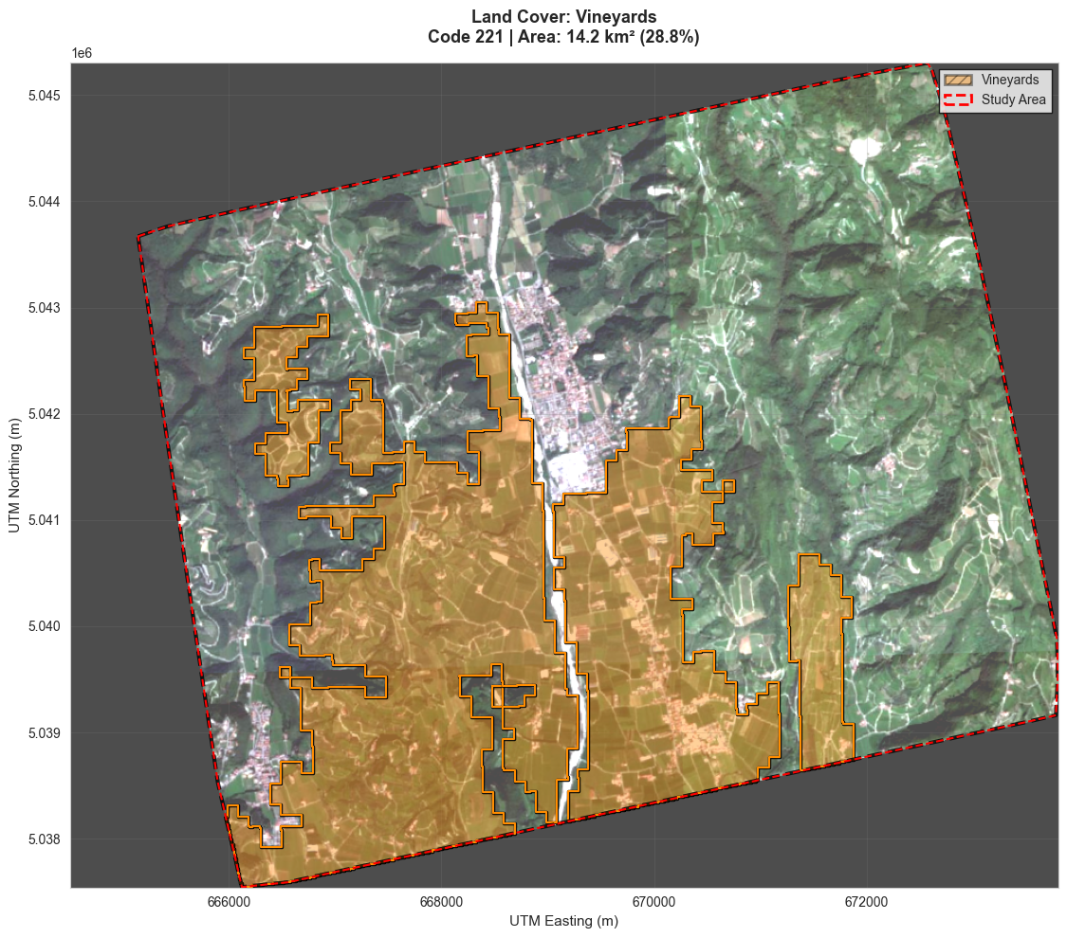
Individual Land Cover Overlay
To understand the spatial distribution, each class was mapped over a satellite image. This example shows the extensive "Vineyards" class, a key agricultural feature in the region.
Drop Image/Figure Here
SAOCOM InSAR Validation Study | Slide 17

Slide 24
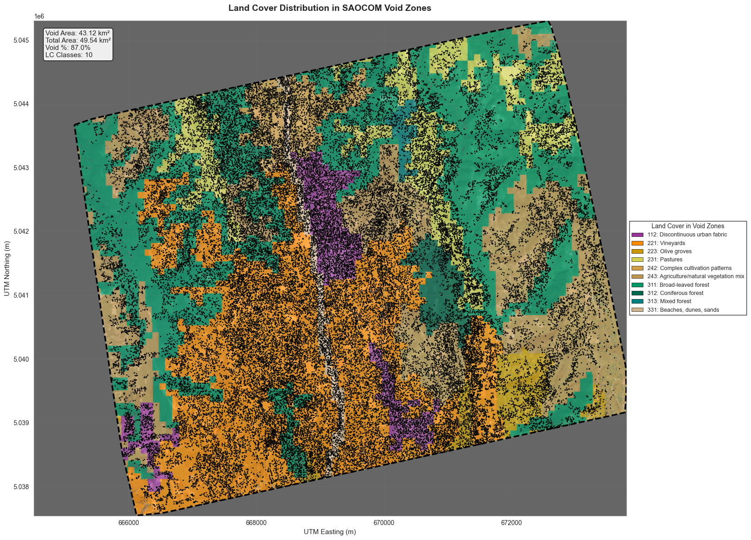
Land Cover Inside the Voids
This map shows only the land cover present in areas where SAOCOM data is missing. It clearly demonstrates that forests, vegetation, and water dominate the data gaps, pointing to decorrelation as the cause.
SAOCOM InSAR Validation Study | Slide 20

Slide 25
Quantifying Void Contributors
These charts pinpoint the most problematic land cover classes. The left chart shows the worst relative coverage (water), while the right chart shows the largest contributors to total void area (forests). [Placeholder for Figure 9: Bar Charts of Void Analysis by Land Cover]
SAOCOM InSAR Validation Study | Slide 21

Slide 26
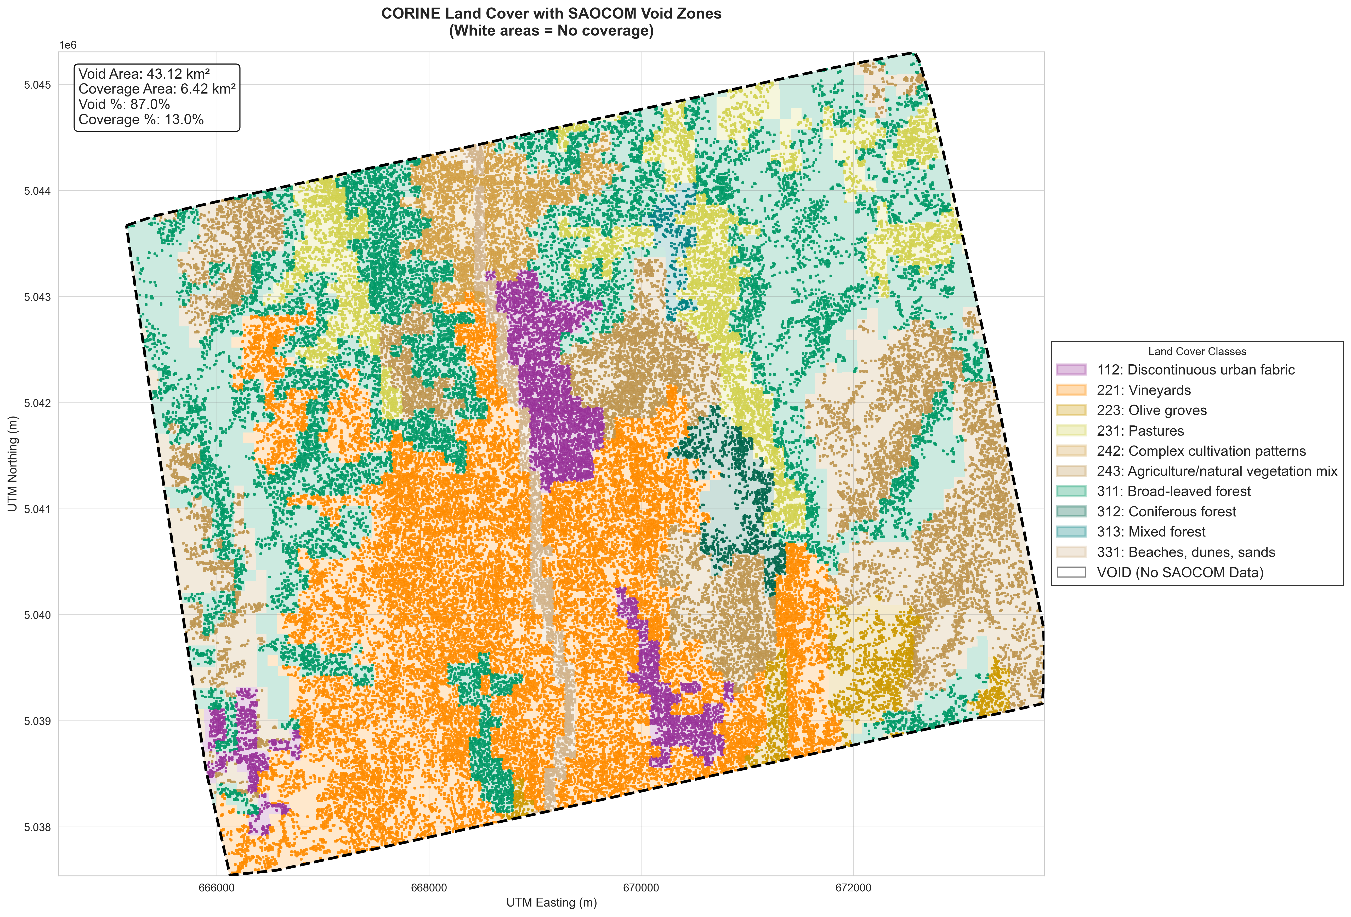
Linking Elevation to Land Cover
Each SAOCOM point was tagged with the specific land cover class it falls on. This creates the final analysis dataset, enabling us to ask: • "How does accuracy change between different categories?" • "Which land cover categories does SAOCOM have difficulty with?"
SAOCOM InSAR Validation Study | Slide 12

Slide 27
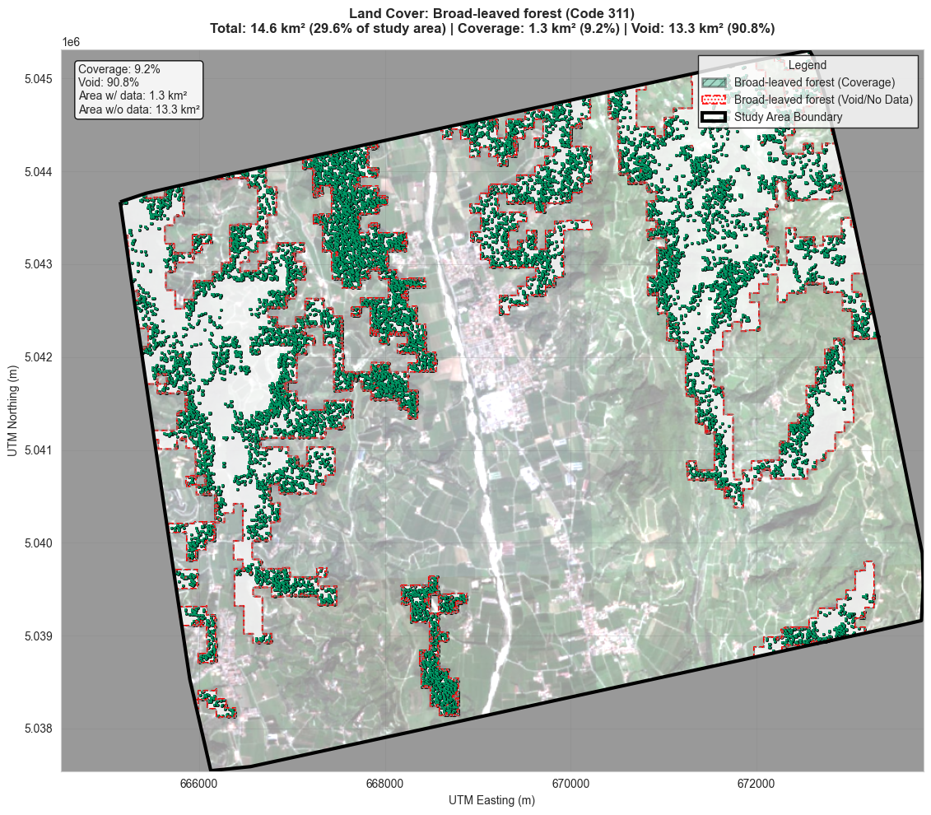
Coverage vs. Voids: A Closer Look
This map zooms in on a single class, partitioning it into areas of successful SAOCOM coverage versus void areas. This is essential for assessing the data's utility for specific applications (e.g., forestry).
Drop Image/Figure Here
SAOCOM InSAR Validation Study | Slide 23

Slide 28
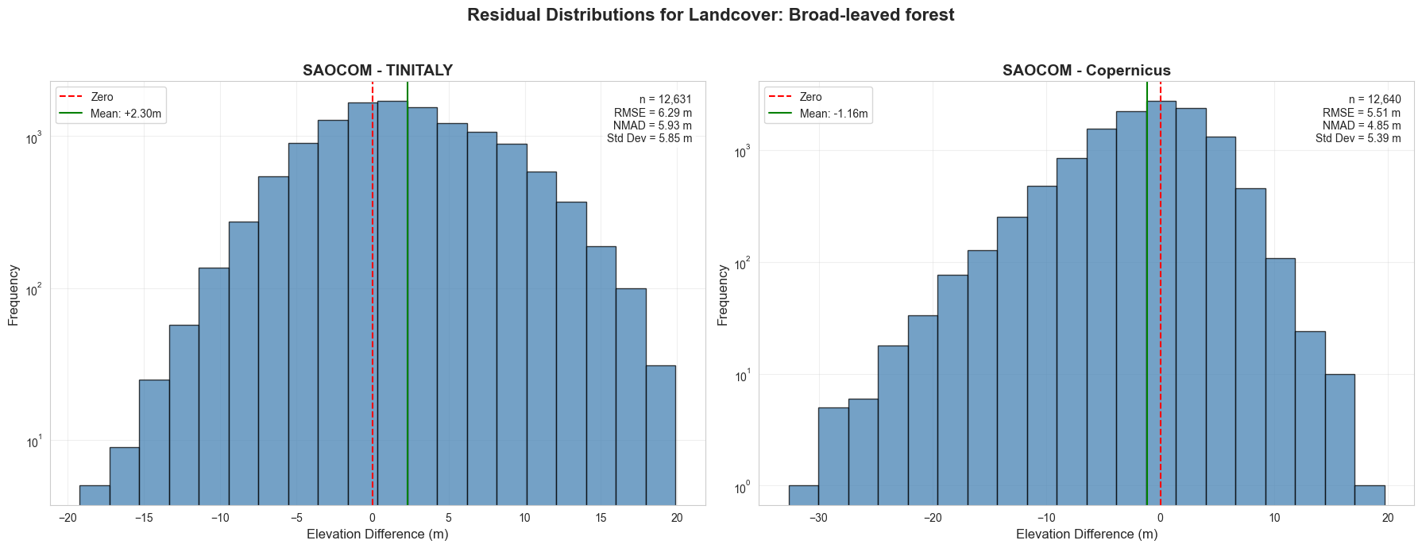
Coverage vs. Voids: A Closer Look
This map zooms in on a single class, partitioning it into areas of successful SAOCOM coverage versus void areas. This is essential for assessing the data's utility for specific applications (e.g., forestry).
SAOCOM InSAR Validation Study | Slide 23

Slide 29
Conclusions
Accuracy: SAOCOM can produce accurate elevation data, but performance is highly dependent on coherence and land cover type. Coverage: The primary limitation is the 87% data void, concentrated in forests, complex vegetation, and water. Utility: Best suited for urban and open agricultural areas; less reliable in vegetated or complex terrain.
SAOCOM InSAR Validation Study | Slide 24

Slide 30
Future Work
• Analyze influence of topography on coverage • Contrast currently generated TINItaly data with Copernicus data for cross validation.
SAOCOM InSAR Validation Study | Slide 25

Slide 31
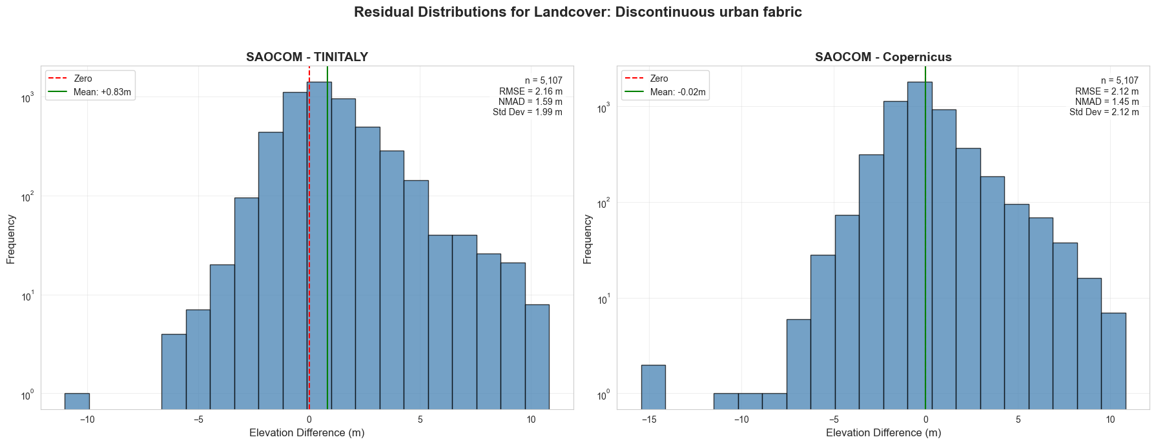

Slide 32
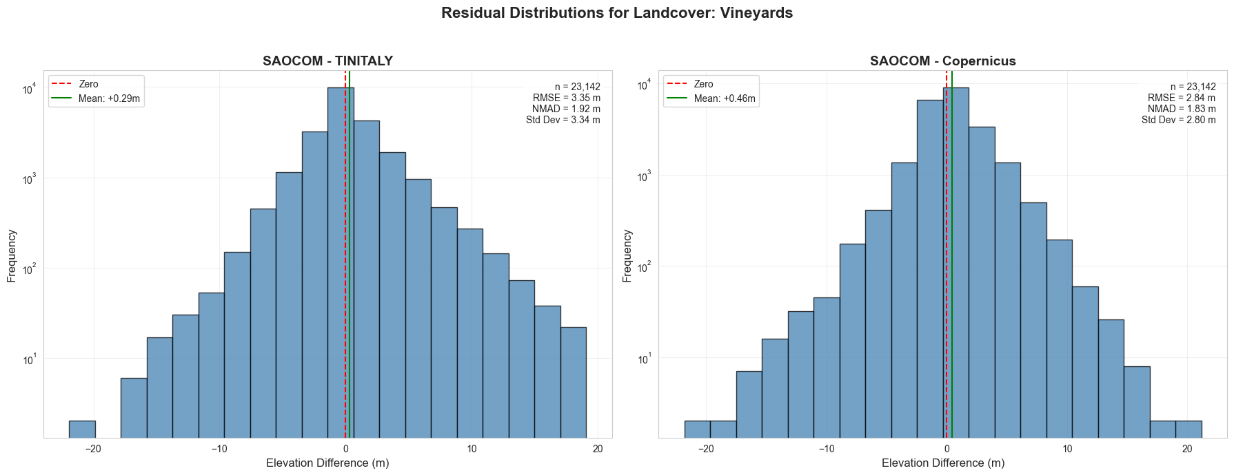

Slide 33
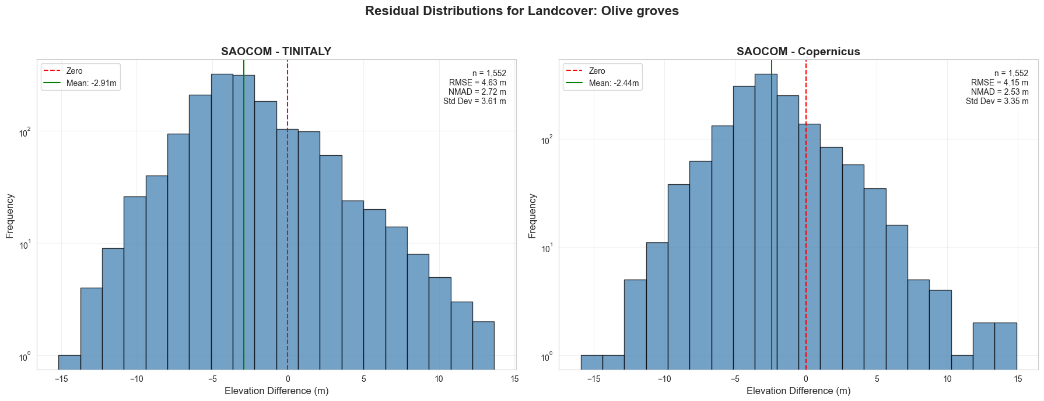

Slide 34
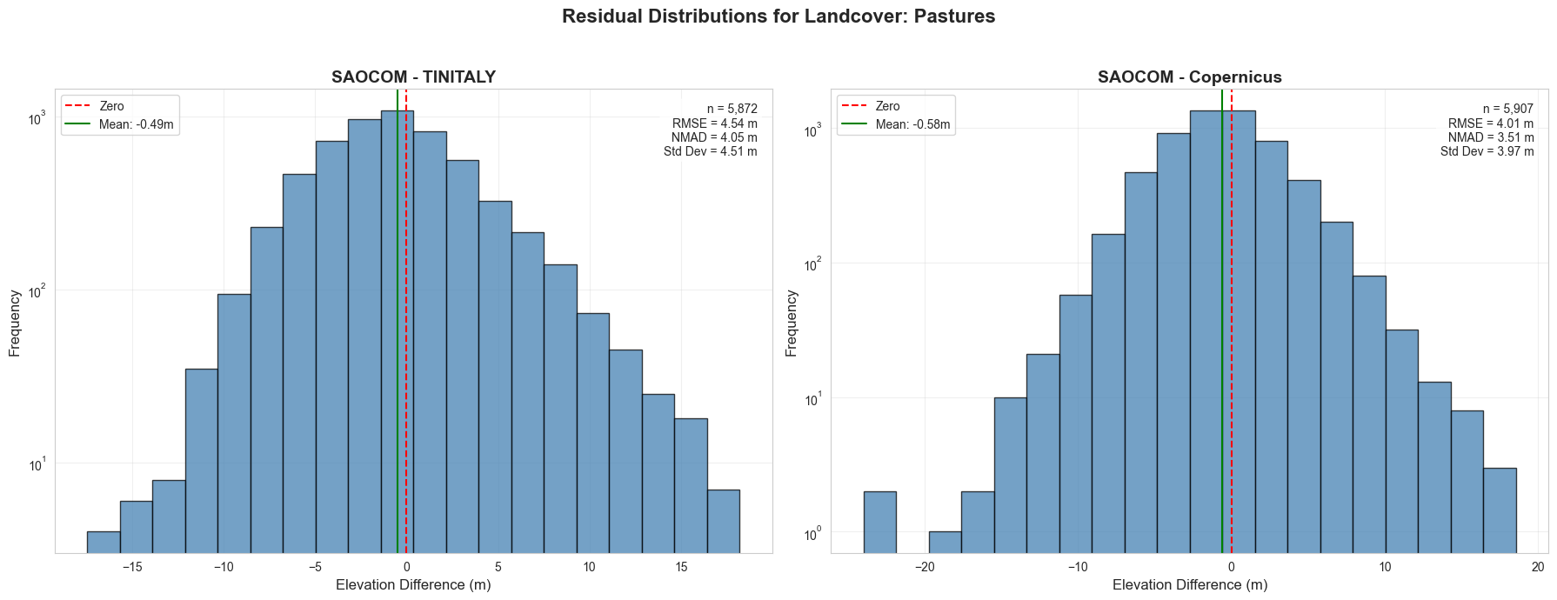

Slide 35
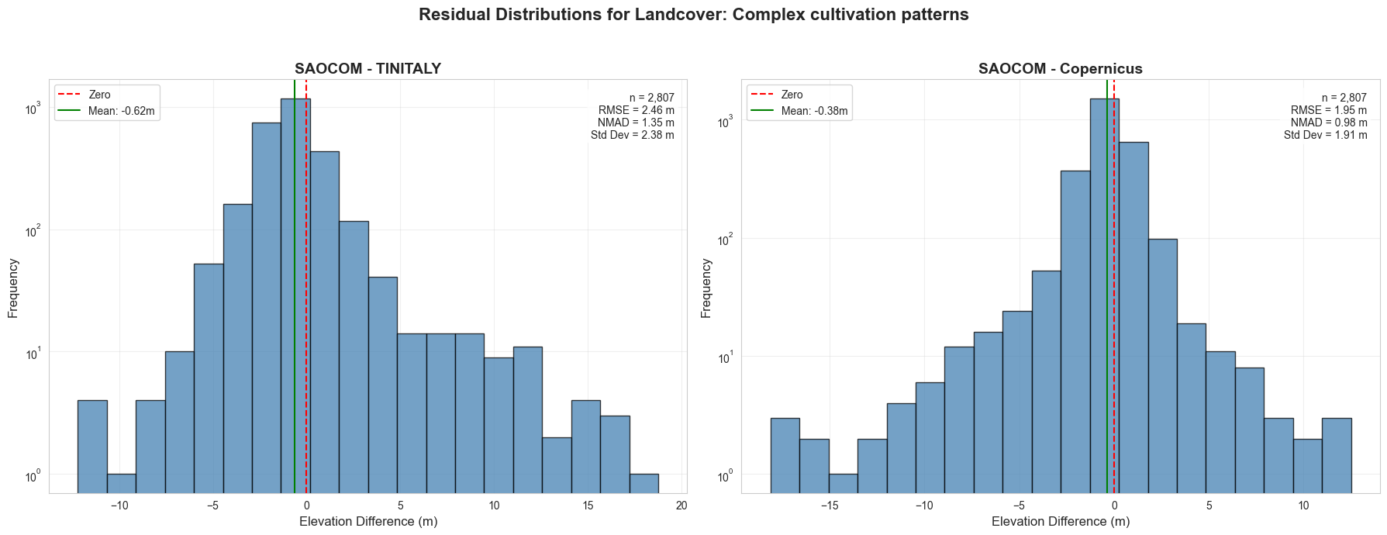

Slide 36
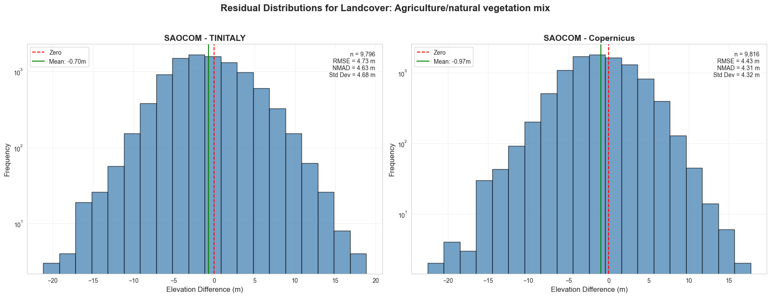

Slide 38
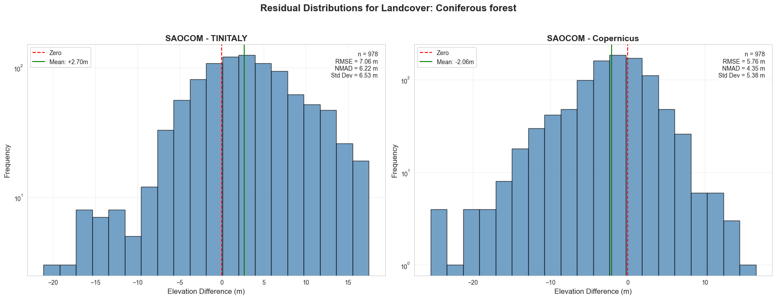

Slide 39
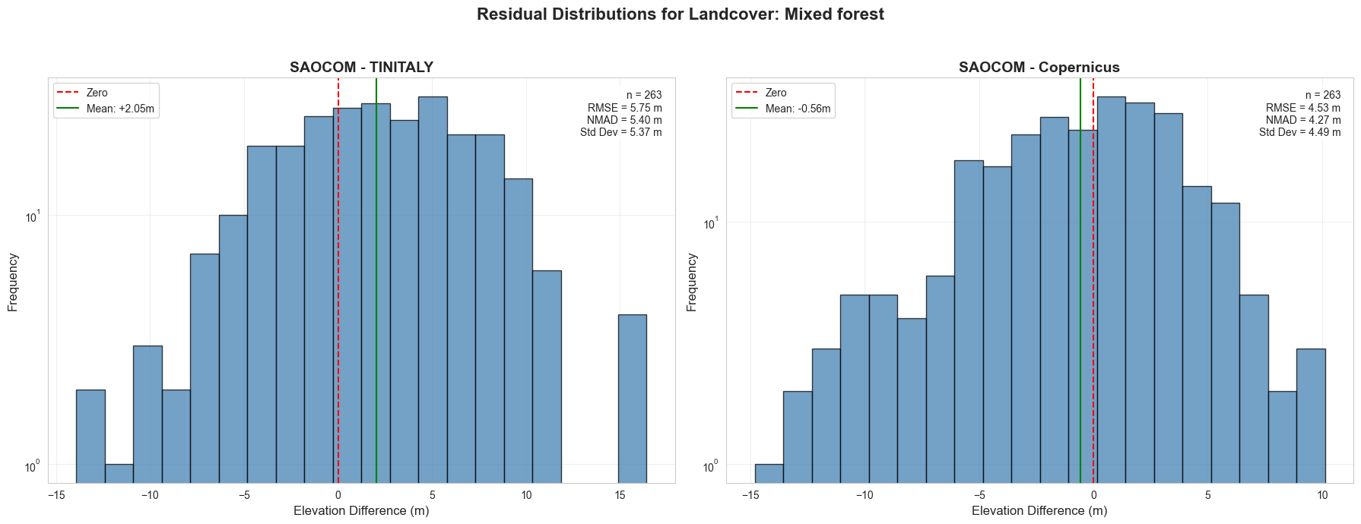

Slide 40
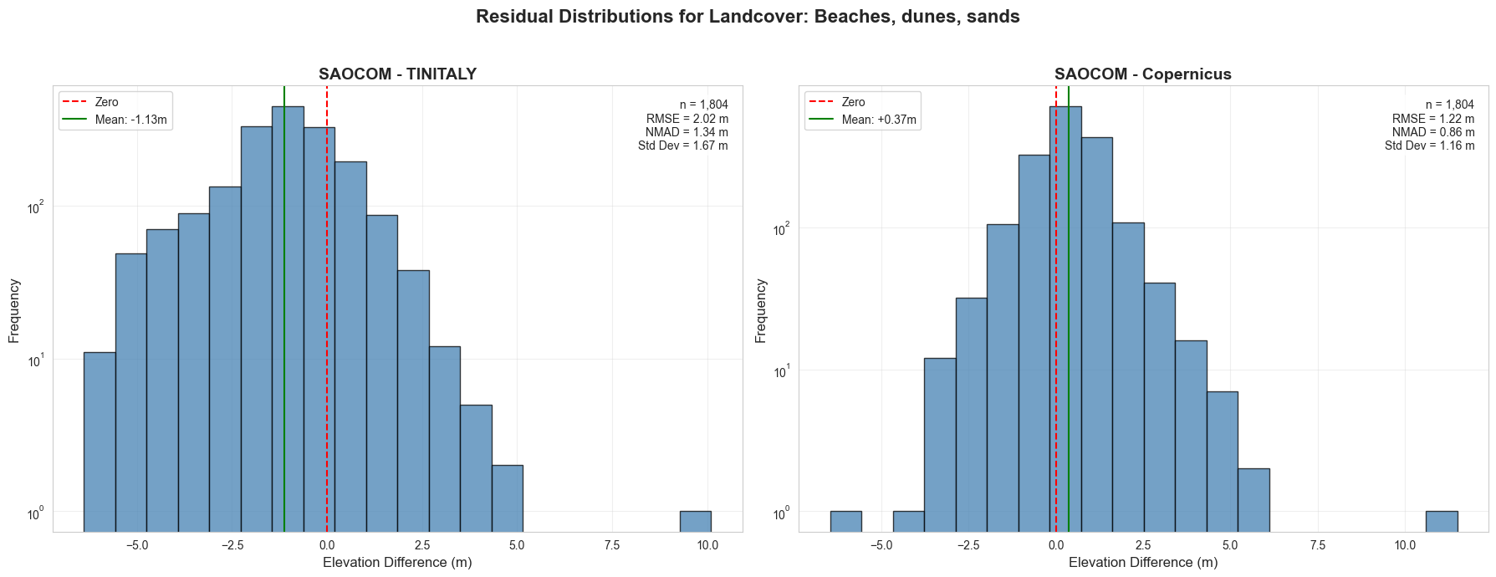

Slide 41
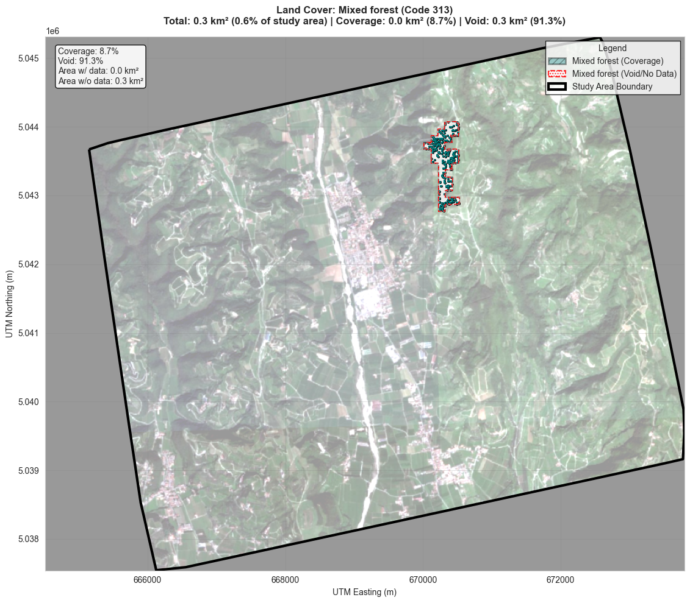

Slide 43
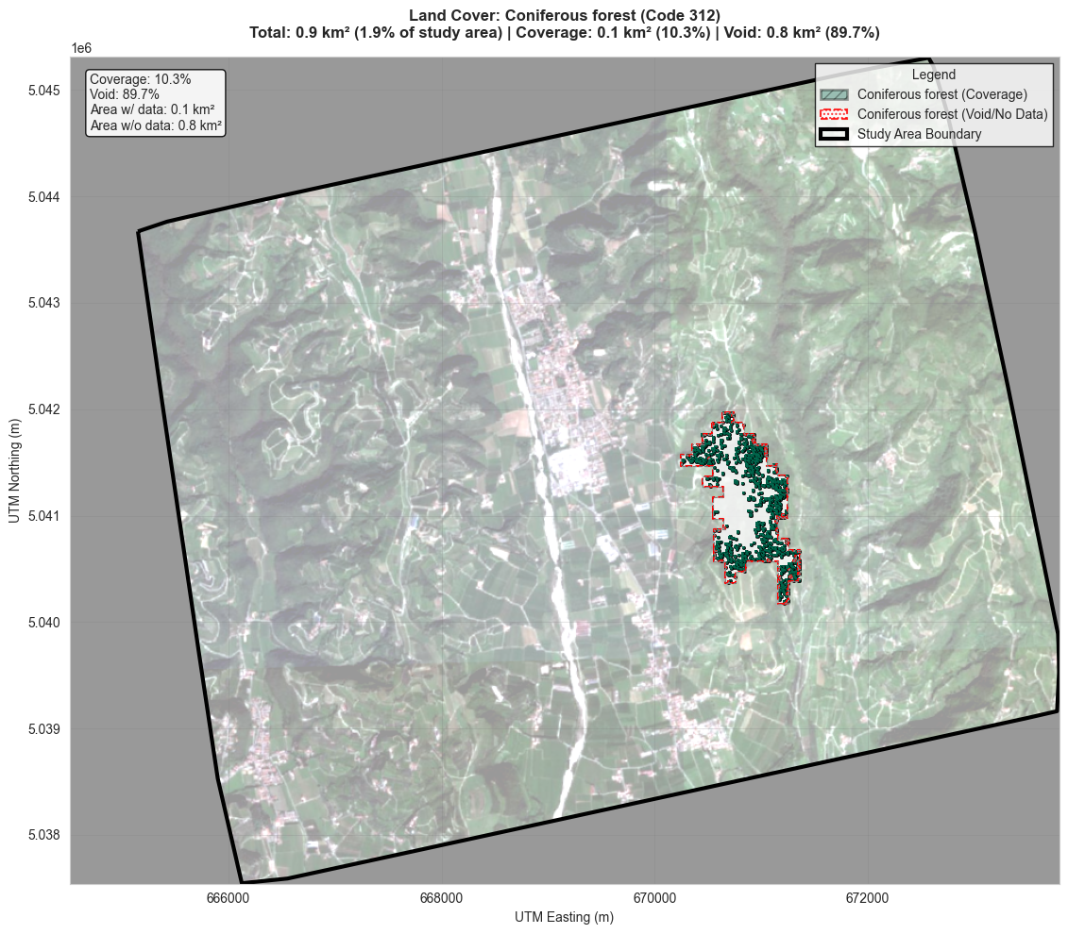

Slide 44
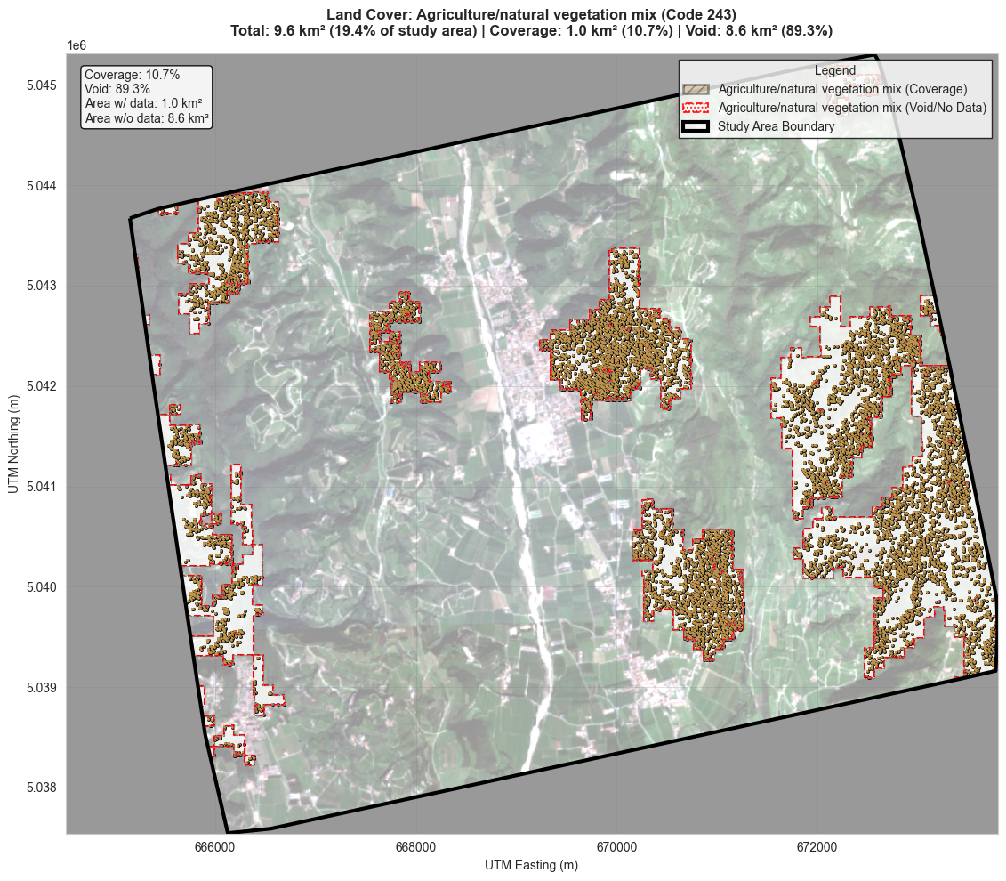

Slide 45
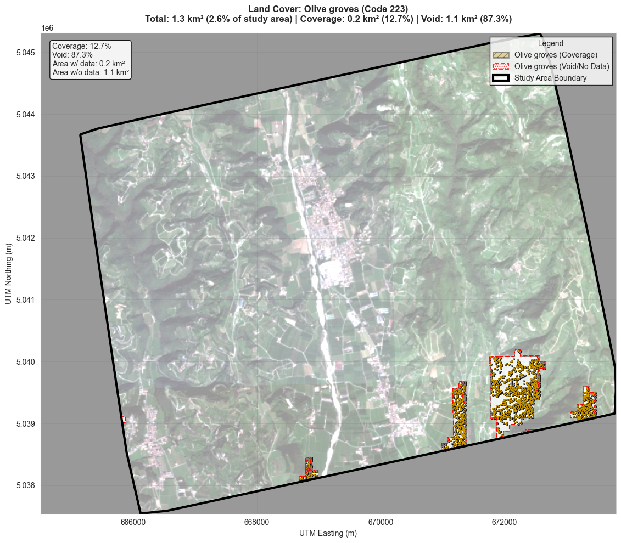

Slide 46
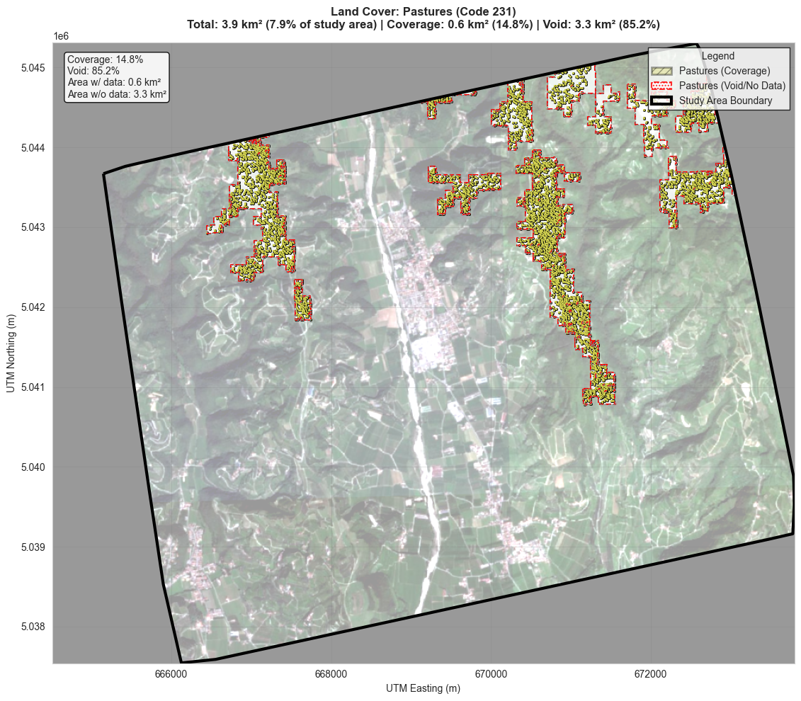

Slide 47
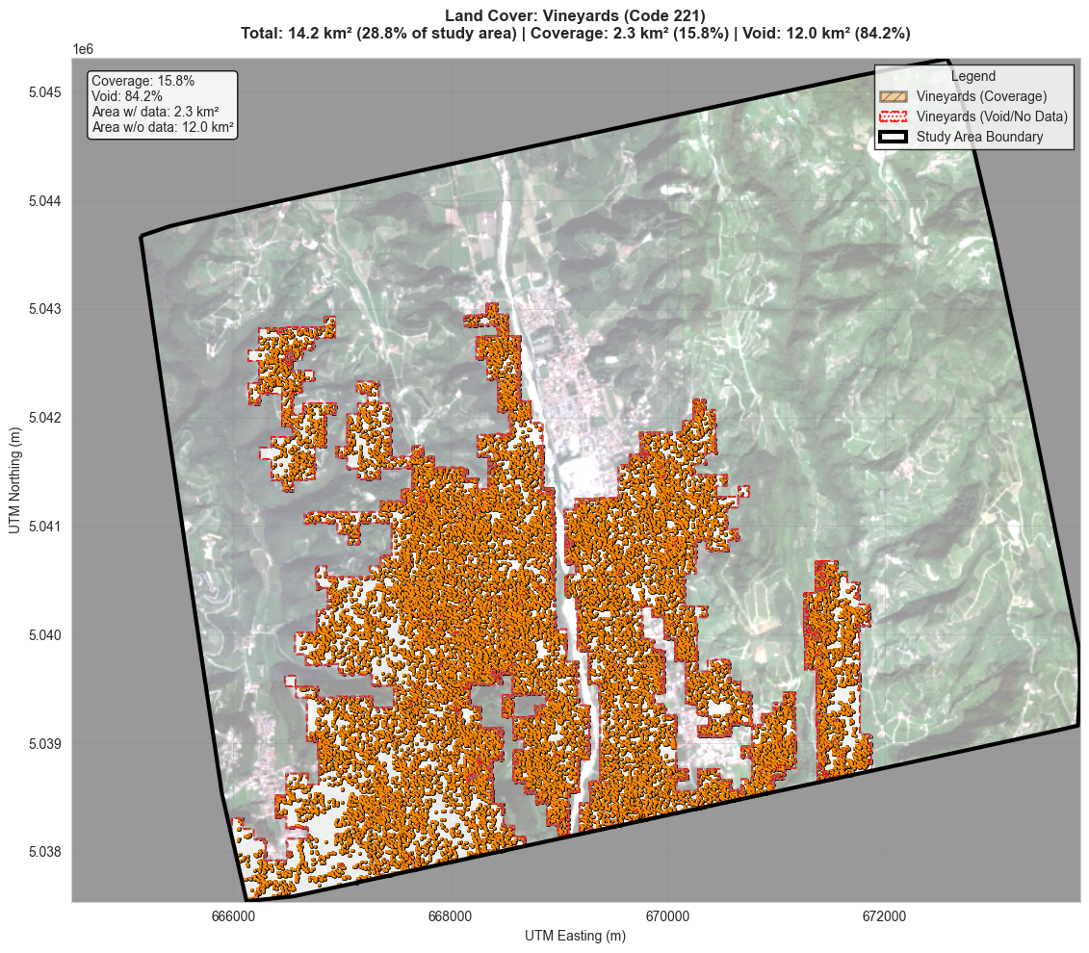

Slide 48
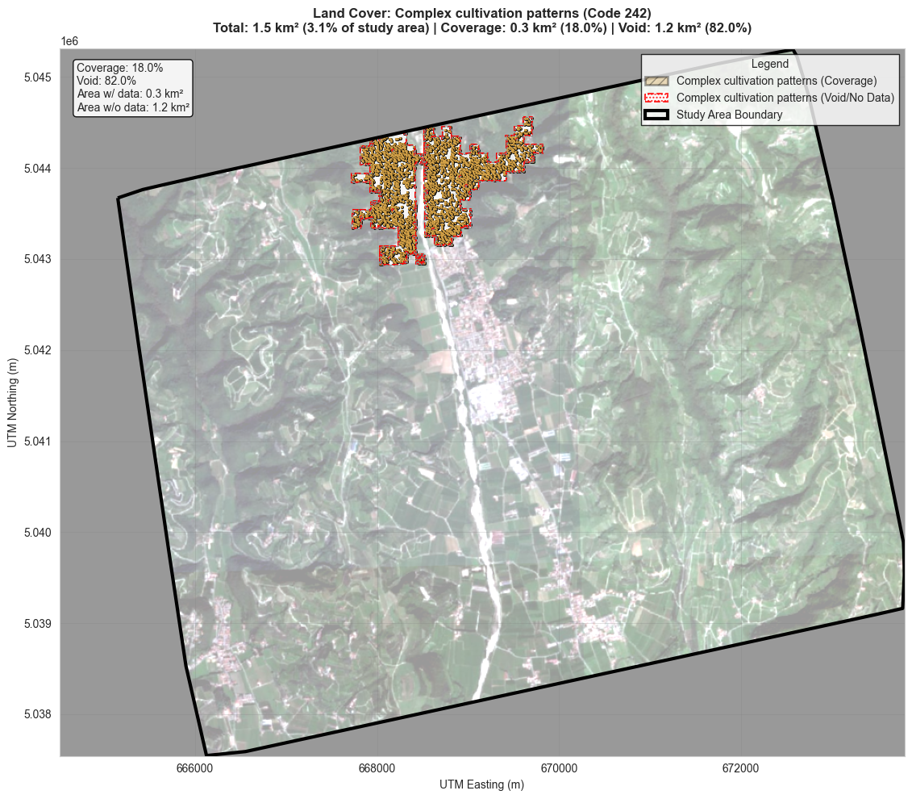

Slide 49
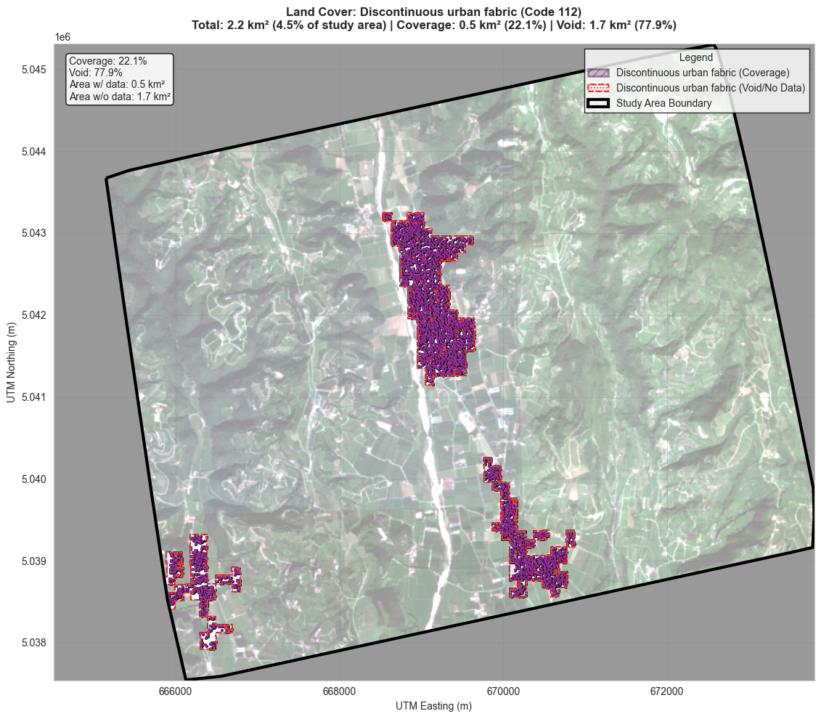

Slide 50
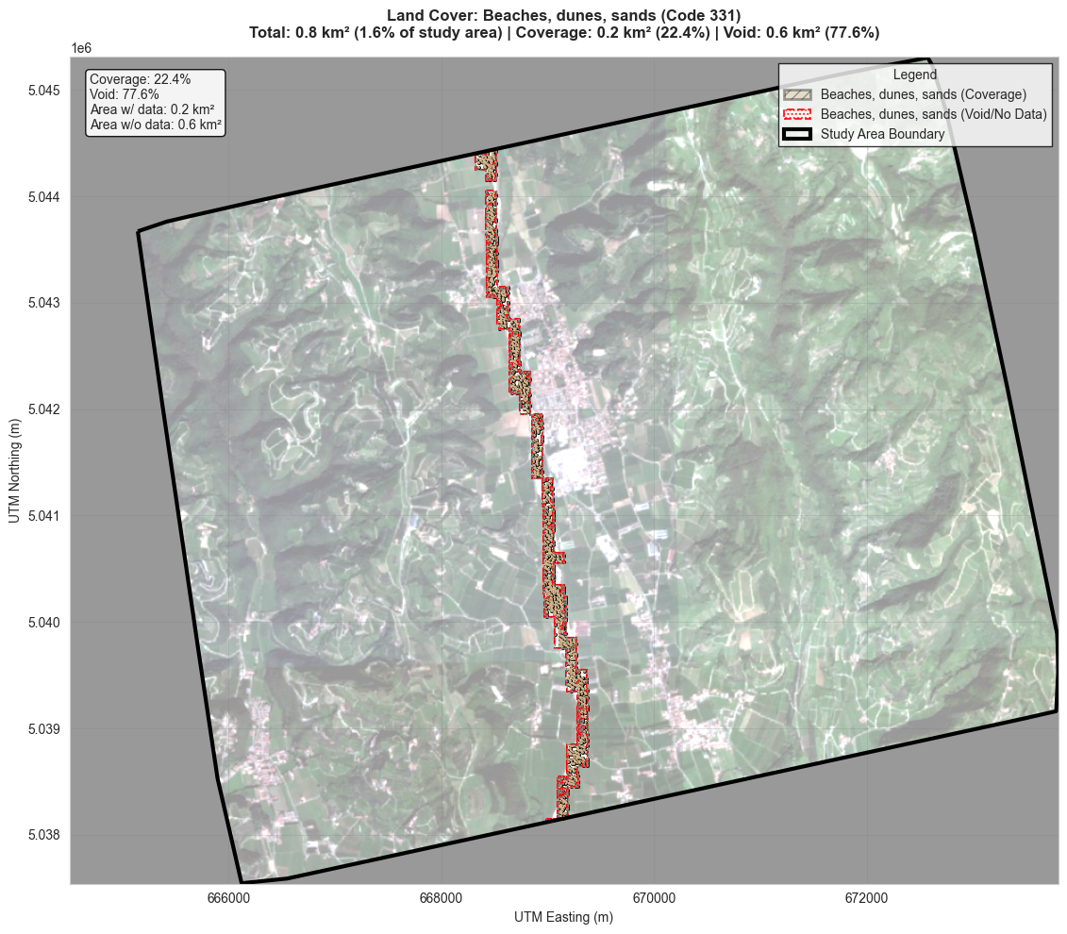

Slide 51
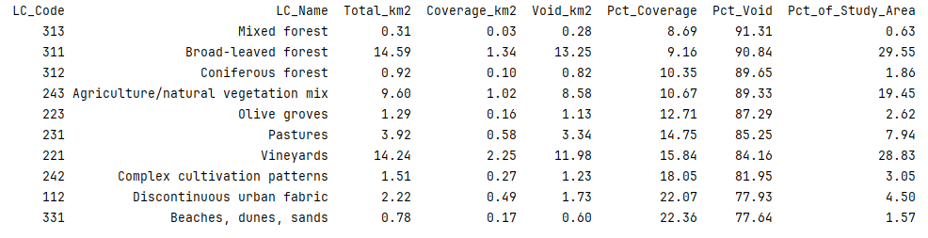

Slide 52
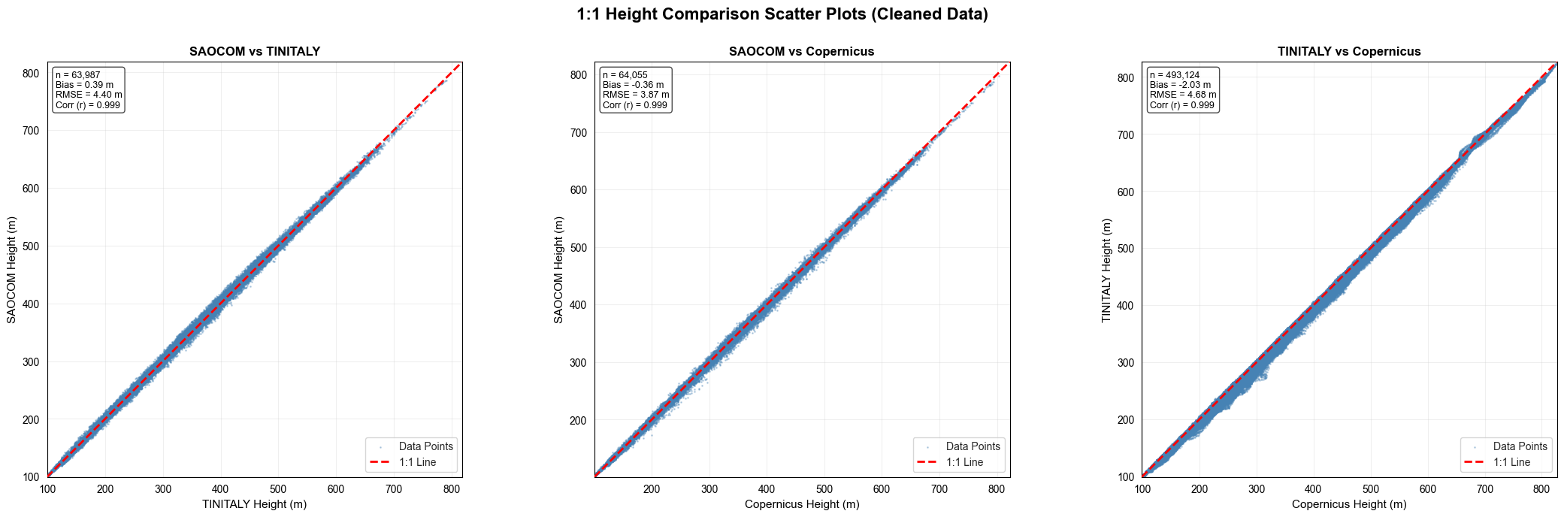

Slide 53
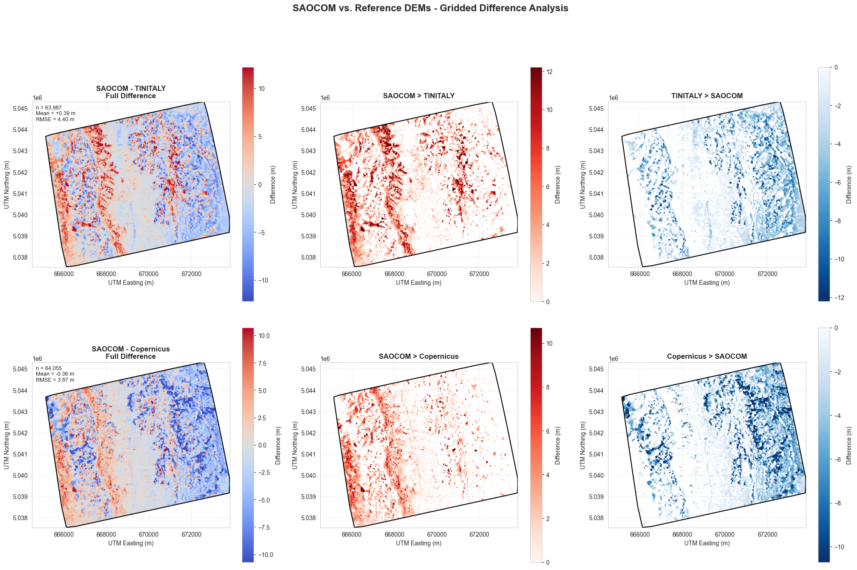

Slide 54
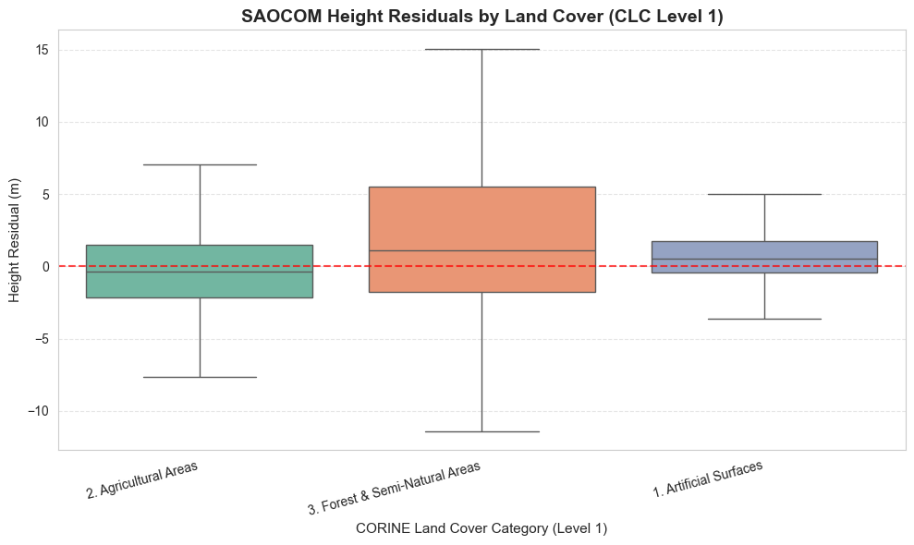

Slide 55
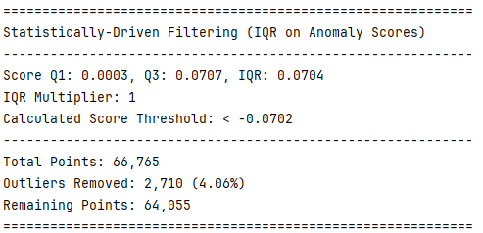
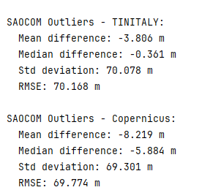

Slide 56


Slide 57


Slide 58



Slide 59


